Slide 1
Basic values for water, cows, feed, energy (per cow averages)
Mega-scale dairy farms (Milking 25k+ Cows)
Water: 1 million+ gal/day (≈3.8 million L), Feed: 625+ tons/day (≈570,000 kg)
Electricity: 150,000+ kWh/day
Thermal energy: 50,000+ kWh/day
Large-scale dairy farms (Milking 5k+ Cows)
Water: 200,000+ gal/day (≈750,000 L), Feed: 125+ tons/day (≈115,000 kg)
Electricity: 30,000+ kWh/day
Thermal energy: 10,000+ kWh/day
Medium-scale dairy farms (Milking 100-500 Cows)
Water: 4,000–20,000 gal/day (15,000–75,000 L), Feed: 2–11 tons/day (≈2,200–11,000 kg)
Electricity: 600–3,000 kWh/day
Thermal energy: 200–1,000 kWh/day
Small-scale dairy farms (Milking >50 Cows)
Water: 2,000 gal/day (7,500 L), Feed: 1.1 tons/day (≈1,100 kg)
Electricity: 250–300 kWh/day
Thermal energy: 100–150 kWh/day
Notes:
Works CitedBecker, Carly. “The Value of Water.” Penn State Extension, 15 Apr. 2024, extension.psu.edu/the-value-of-water.
Cisan, Jerry, et al. Documentation for the USDA, Economic Research Service Annual U.S. Dairy Sector Econometric Model. USDA, 13 July 2023.
Council, National Research. Nutrient Requirements of Dairy Cattle: Seventh Revised Edition, 2001. Nap.nationalacademies.org, National Research Council, 1 Nov. 2000, nap.nationalacademies.org/catalog/9825/nutrient-requirements-of-dairy-cattle-seventh-revised-edition-2001.

Slide 2
Dynamic Complexity
Systems are:
Constantly changing
Tightly coupled (“you can’t do just one thing”)
Governed by feedback
Nonlinear and history-dependent
Self-organizing and adaptive
Characterized by trade-offs and counterintuitive outcomes
Resistant to simple policies

Slide 3
System Dynamics Modeling Principles
Broad model boundaries (few exogenous variables).
Include qualitative “soft” variables, not just hard data.
Equations must respect information limits and physical laws.
Models should be robust, transparent, and open to stakeholder review.
Simulation is a learning tool, not a black box to justify decisions.
Notes:
Ultimately, system dynamics uses models to solve problems, not just describe systems, includes wide boundaries to capture hidden feedbacks and delays, combines quantitative and qualitative data, engages stakeholders throughout the process, keeps models transparent (“open box”) to build trust and shared learning.
Iterative process: refine both formal models and mental models over time.

Slide 4
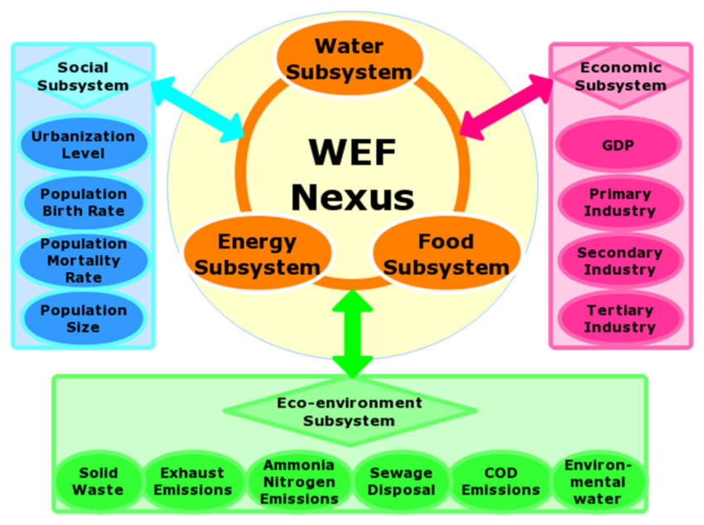
Notes:
https://www.researchgate.net/figure/Framework-of-the-water-energy-food-WEF-nexus-system-dynamics-SD-model_fig2_342209208

Slide 5
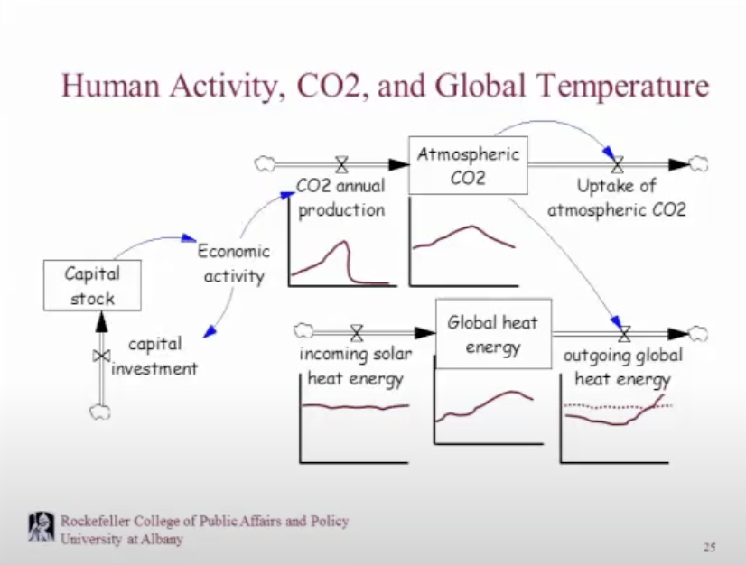
Notes:
https://www.vensim.com/documentation/
https://www.youtube.com/watch?v=MSo8kqbLDlw&list=PLrSp4pjHugDNRoL-BgV431OfOup2WbhGL&index=21

